Slide 1
Data Edit Tool

Slide 2
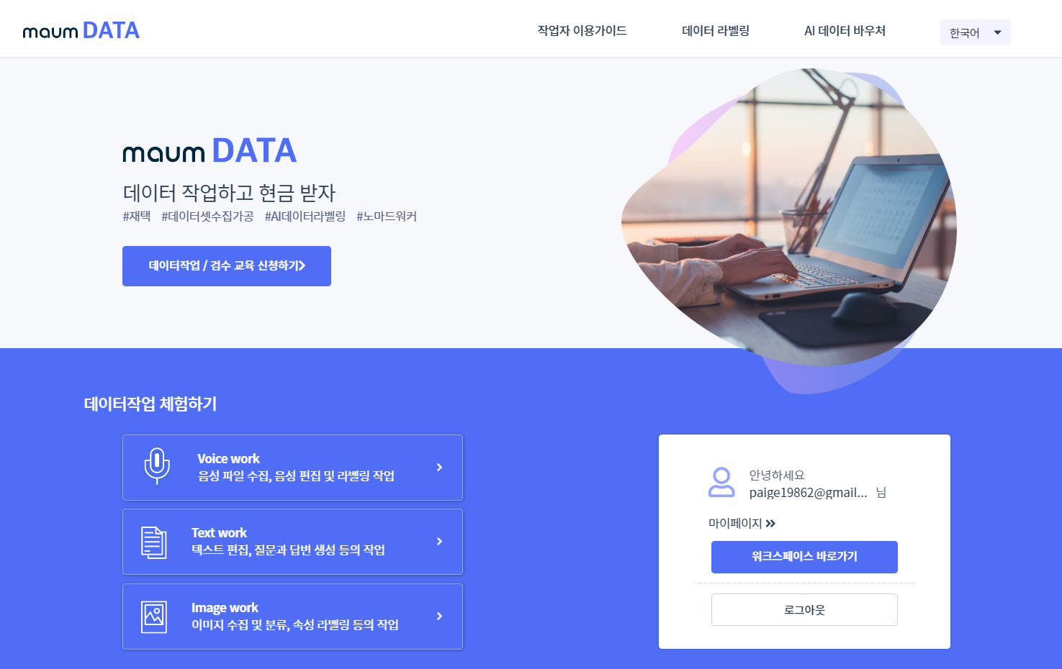
User Guide
Data Labeling
AI Data Voucher
Korean
Work and Get Paid the Same Day
#Work from home #Data collection #Data labeling
Sign Up for Online Training
Try Sample Projects
Edit and label audio files
Welcome,
paige19862@gmail
My page
Edit text files, creating Q&As
Workspace
Logout
Classify and label image files

Slide 3
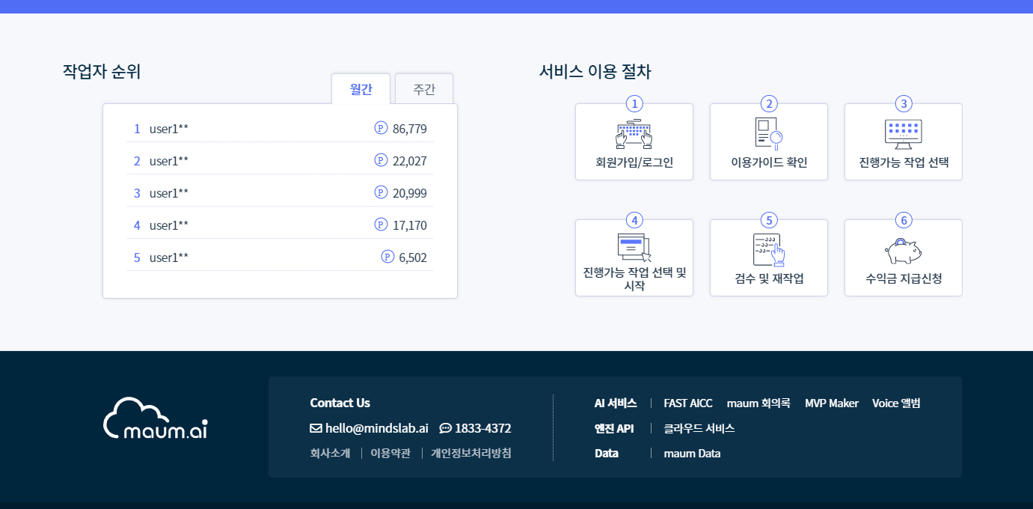
Ranking
Monthly
Weekly
maum DATA Service
Sign Up & Sign In
Read User Guide
Select Projects
Start the Project
Find and Correct Errors
Get Paid
maum Minutes
Voice Album
API Engine
Cloud Services
Company
Terms of Condition
Privacy Policy

Slide 4
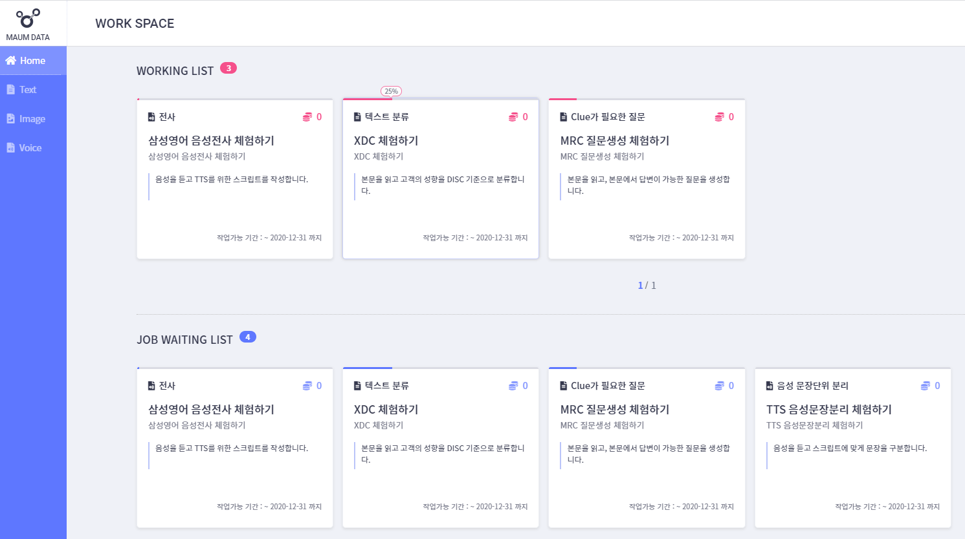
Transcription
Document Classification
Machine Reading
Comprehension
As you listen audio files transcribe
Listen and read customer conversation and classify
Make questions on the passage
Data will be used for Text-to-Speech
Classify the whole passage and tag clues
Create questions and match answers in the passage
Due Date: - 2020.12.31
Due Date: - 2020.12.31
Due Date: - 2020.12.31

Slide 5
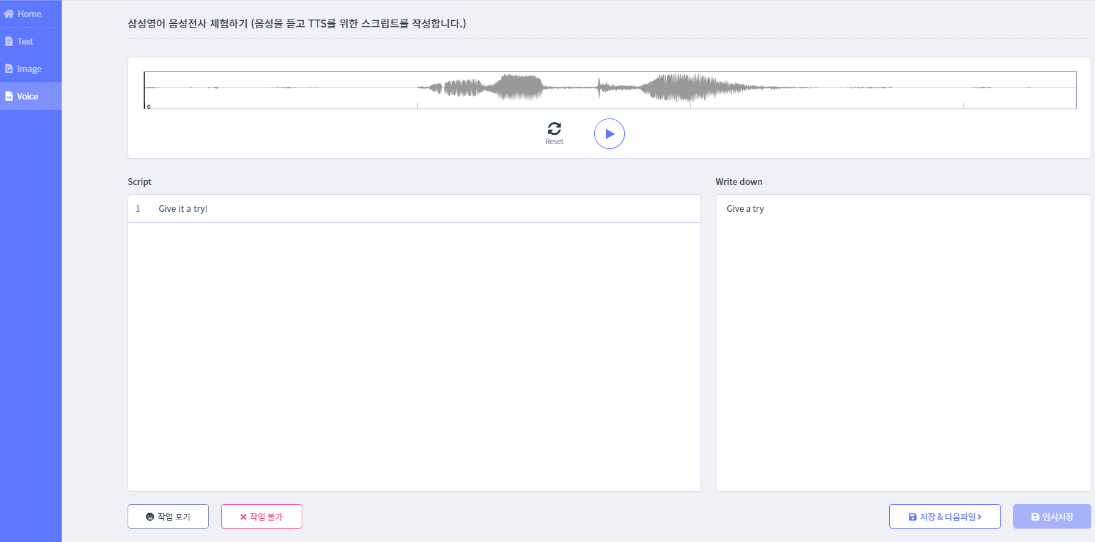
Audio Transcription

Slide 6
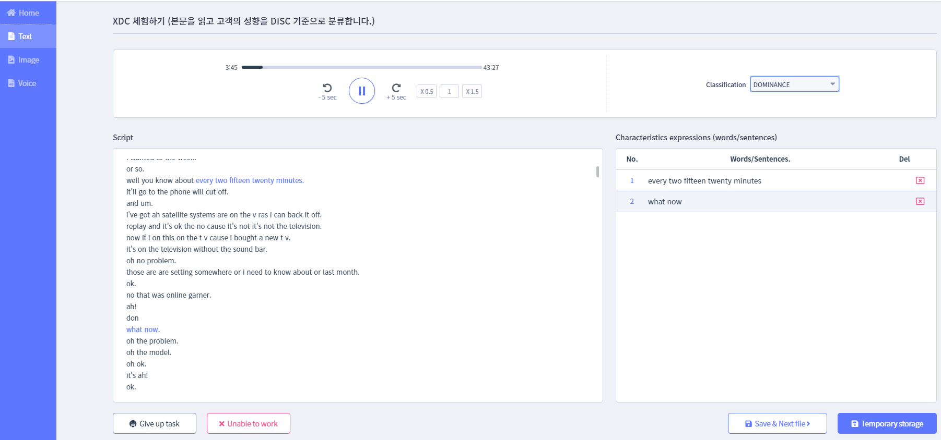
Categorize Passages and Tag Expressions

Slide 7
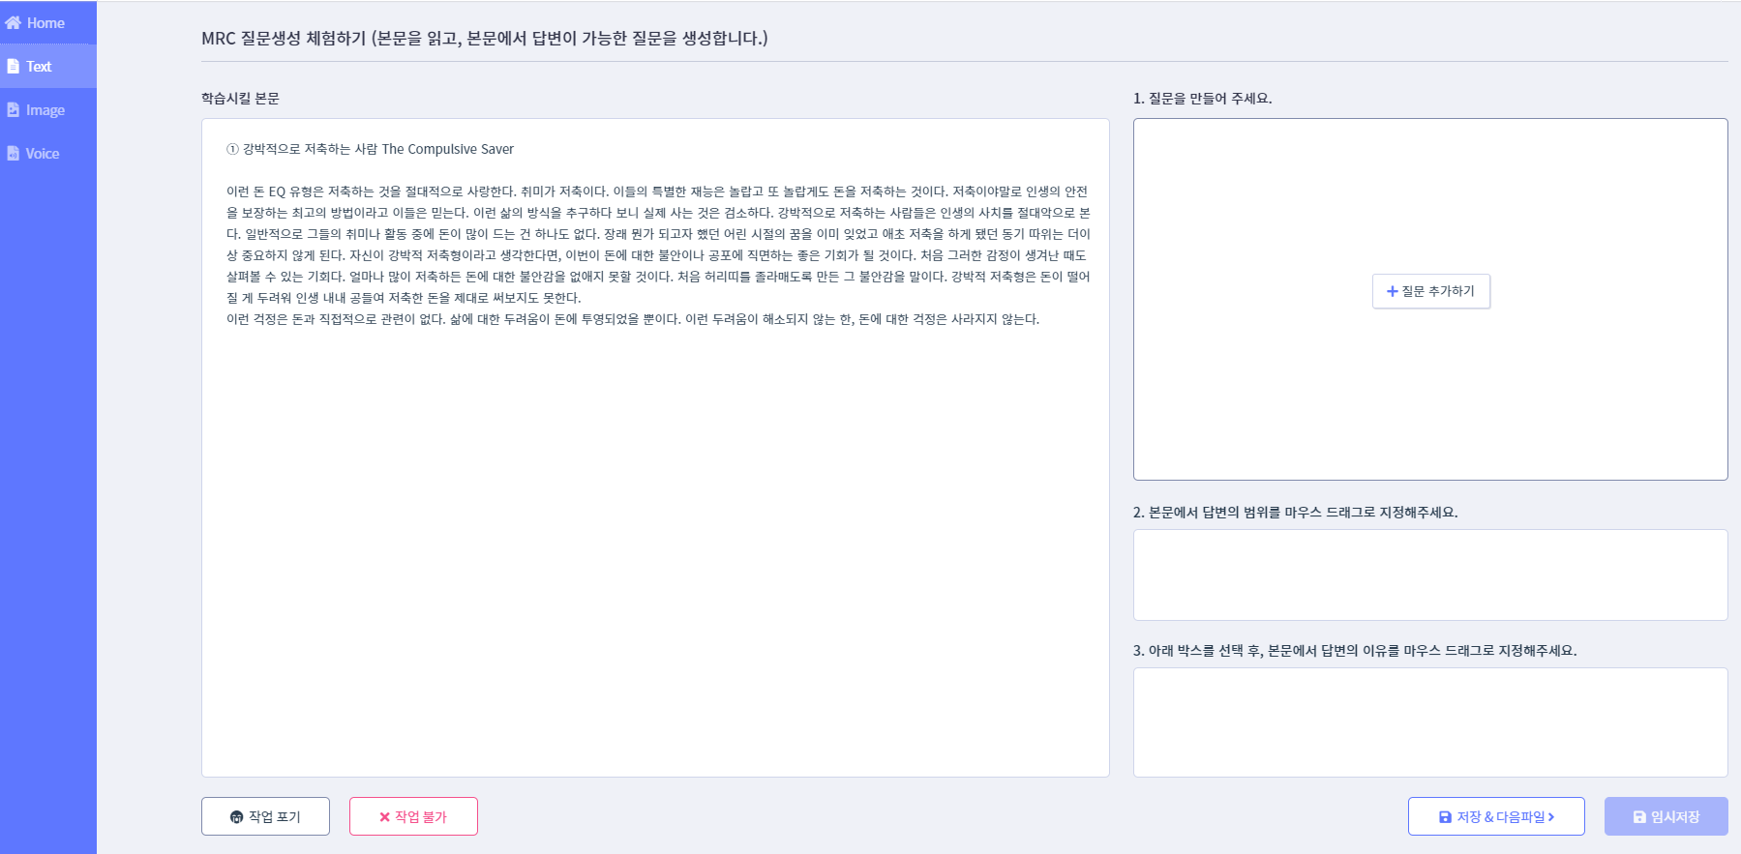
Machine Reading Comprehension Data

Slide 8
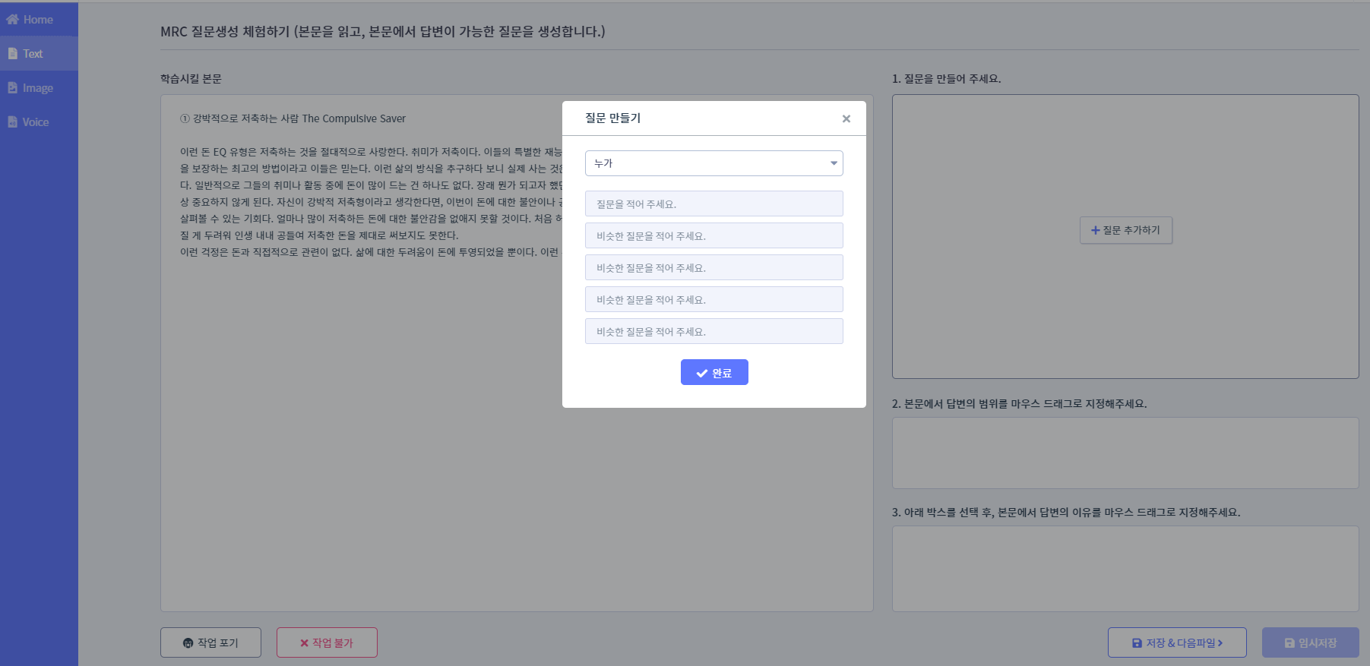
Machine Reading Comprehension Data

Slide 9
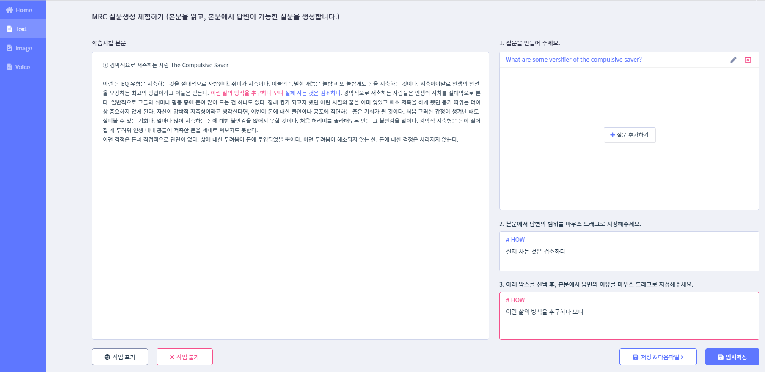
Machine Reading Comprehension Data

Slide 10
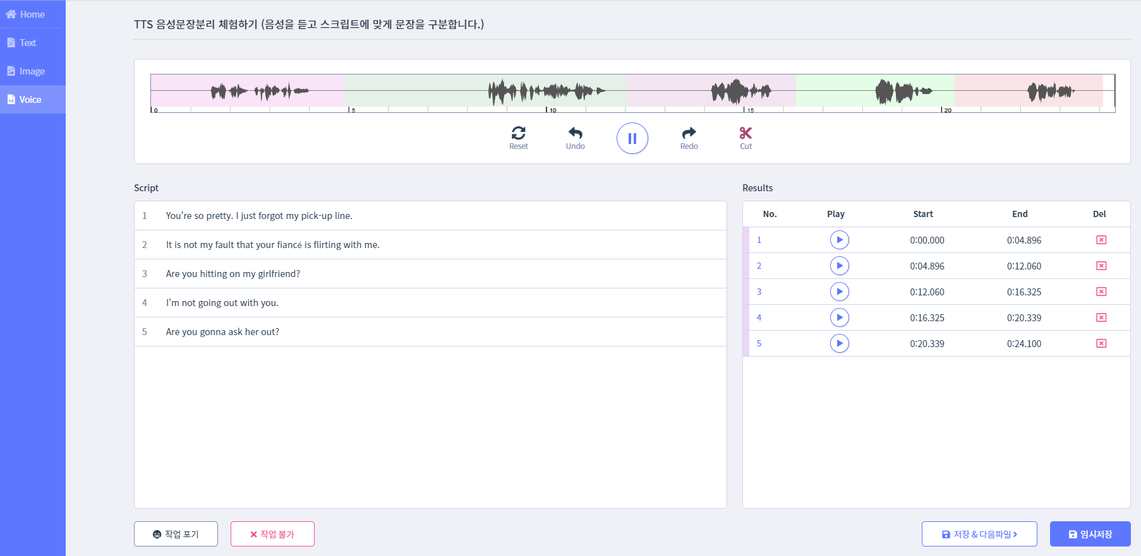
Separate Scripts/Audio into Sentences.(?)

